Slide 1

COPA Airlines for POC
Amal Jadoon & Catalina Pena

Slide 2
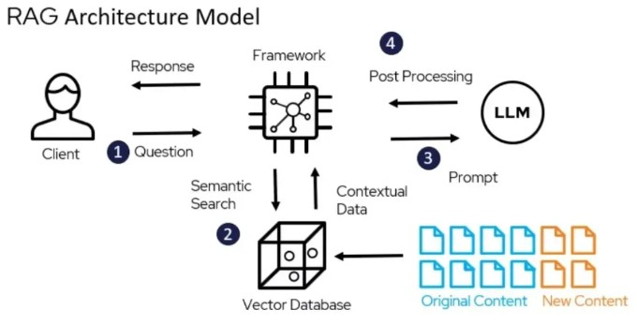
Context
Modern organizations face increasing regulatory and operational complexity, with many required to comply with multiple frameworks at once (Coalfire, 2023).
Traditional manual assessment processes have several limitations:
Time and resource intensive
Inconsistent results between evaluators
Performed periodically, not continuously
Difficult to compare across frameworks
Poor scalability
Limited traceability
The proposed solution uses language models and a RAG architecture to analyze organizational policies and controls, identifying compliance coverage, gaps, and maturity levels with supporting evidence.

Slide 3
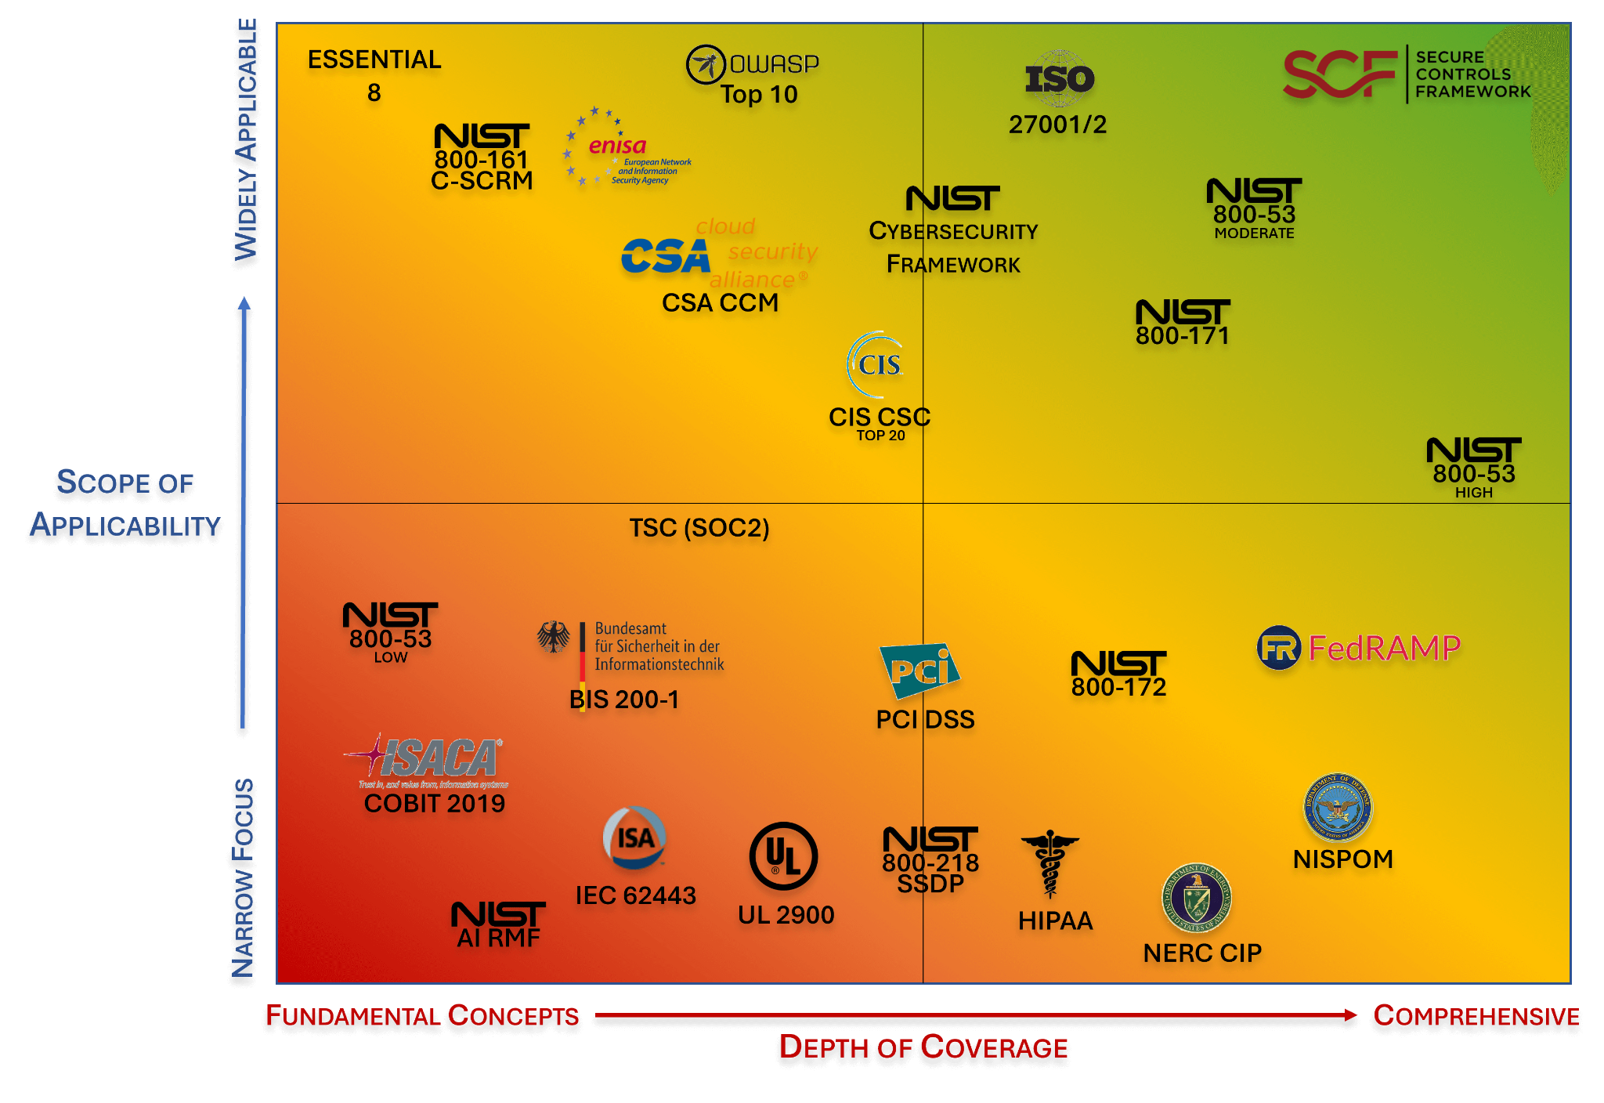
Summary
The proposal aims to establish a collaboration for a pilot of an automated cybersecurity maturity and compliance assessment tool using LLMs, RAG, and semantic policy analysis.
Developed through the Duke Cybersecurity Program, it addresses key Governance, Risk & Compliance challenges in consistently and efficiently evaluating multiple security and regulatory frameworks.
The tool produces structured outputs including maturity assessments, gap analyses, traceable evidence, prioritized recommendations, and domain-based security scoring.
The system analyzes organizational documents such as: security policies, technical standards, procedures, operational guidelines, internal controls, compliance guides, internal frameworks. | And compares them against frameworks such as NIST Cybersecurity Framework 2.0, NIST SP 800-53, ISO 27001, CIS Controls, PCI DSS, CMMC, HIPAA, CSA CCM, FTC Safeguards Rule.

Slide 4

Objective
To validate the tool’s ability to:
Reduce assessment and document analysis time
Automate multi-framework evaluations
Improve visibility into cybersecurity maturity
Identify compliance gaps and improvement areas
Generate auditable and explainable evidence
Support audit and governance processes
The pilot evaluates the feasibility of using AI to support GRC and cybersecurity processes in a highly digitalized and critical organization such as an airline.

Slide 5
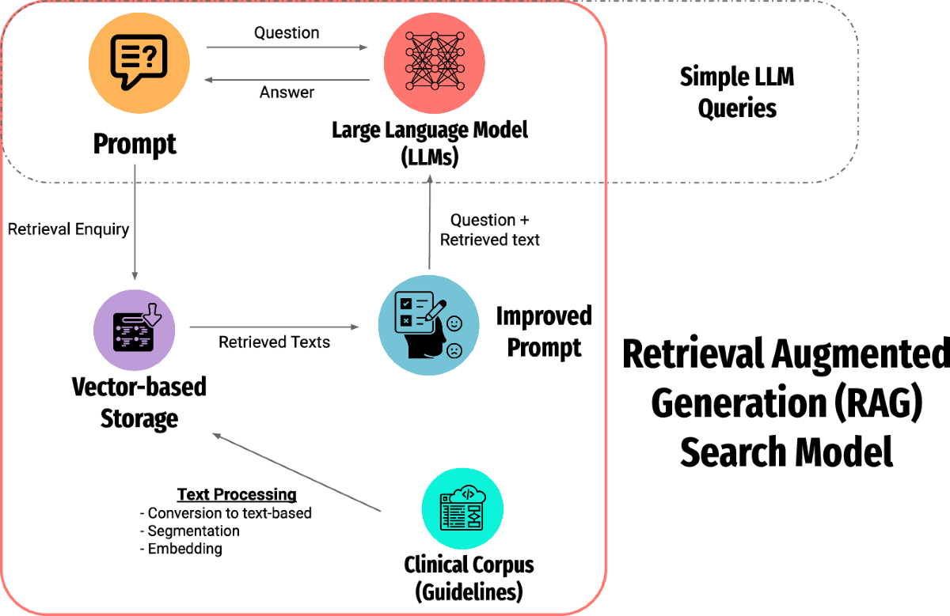
Tool
The platform uses an architecture based on Large Language Models (LLMs), Retrieval-Augmented Generation (RAG), semantic policy analysis, structured explainability, and Human-in-the-Loop validation to ensure traceability, auditability, and oversight.
The tool:
Ingests organizational documentation
Segments and semantically vectorizes content
Retrieves evidence per control
Evaluates alignment with frameworks
Generates maturity scores (0–5)
Produces gap analyses and recommendations
Maintains traceability and explainability
The design also reduces hallucinations by using RAG and restricting outputs to retrieved documentary evidence only.

Slide 6
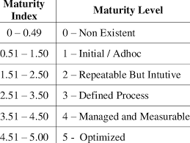
Expected Benefits
The pilot would provide strategic, operational, and technical benefits.
From a strategic perspective, it would improve visibility into cybersecurity posture across multiple frameworks, strengthening governance, risk, and compliance processes. It would also support audits and regulatory interactions by generating structured, traceable evidence and enable a risk-based maturity and remediation roadmap.
At the operational level, the tool would reduce time spent on assessments and document review, automate GRC workflows, standardize evaluations, and improve consistency. It would also help identify compliance gaps and prioritize remediation based on impact and criticality.
From a technical perspective, the solution relies on evidence-based, auditable, and explainable outputs. It reduces inconsistencies from manual analysis and provides scalability for evaluating multiple cybersecurity and compliance domains within a single environment.

